Slide 1
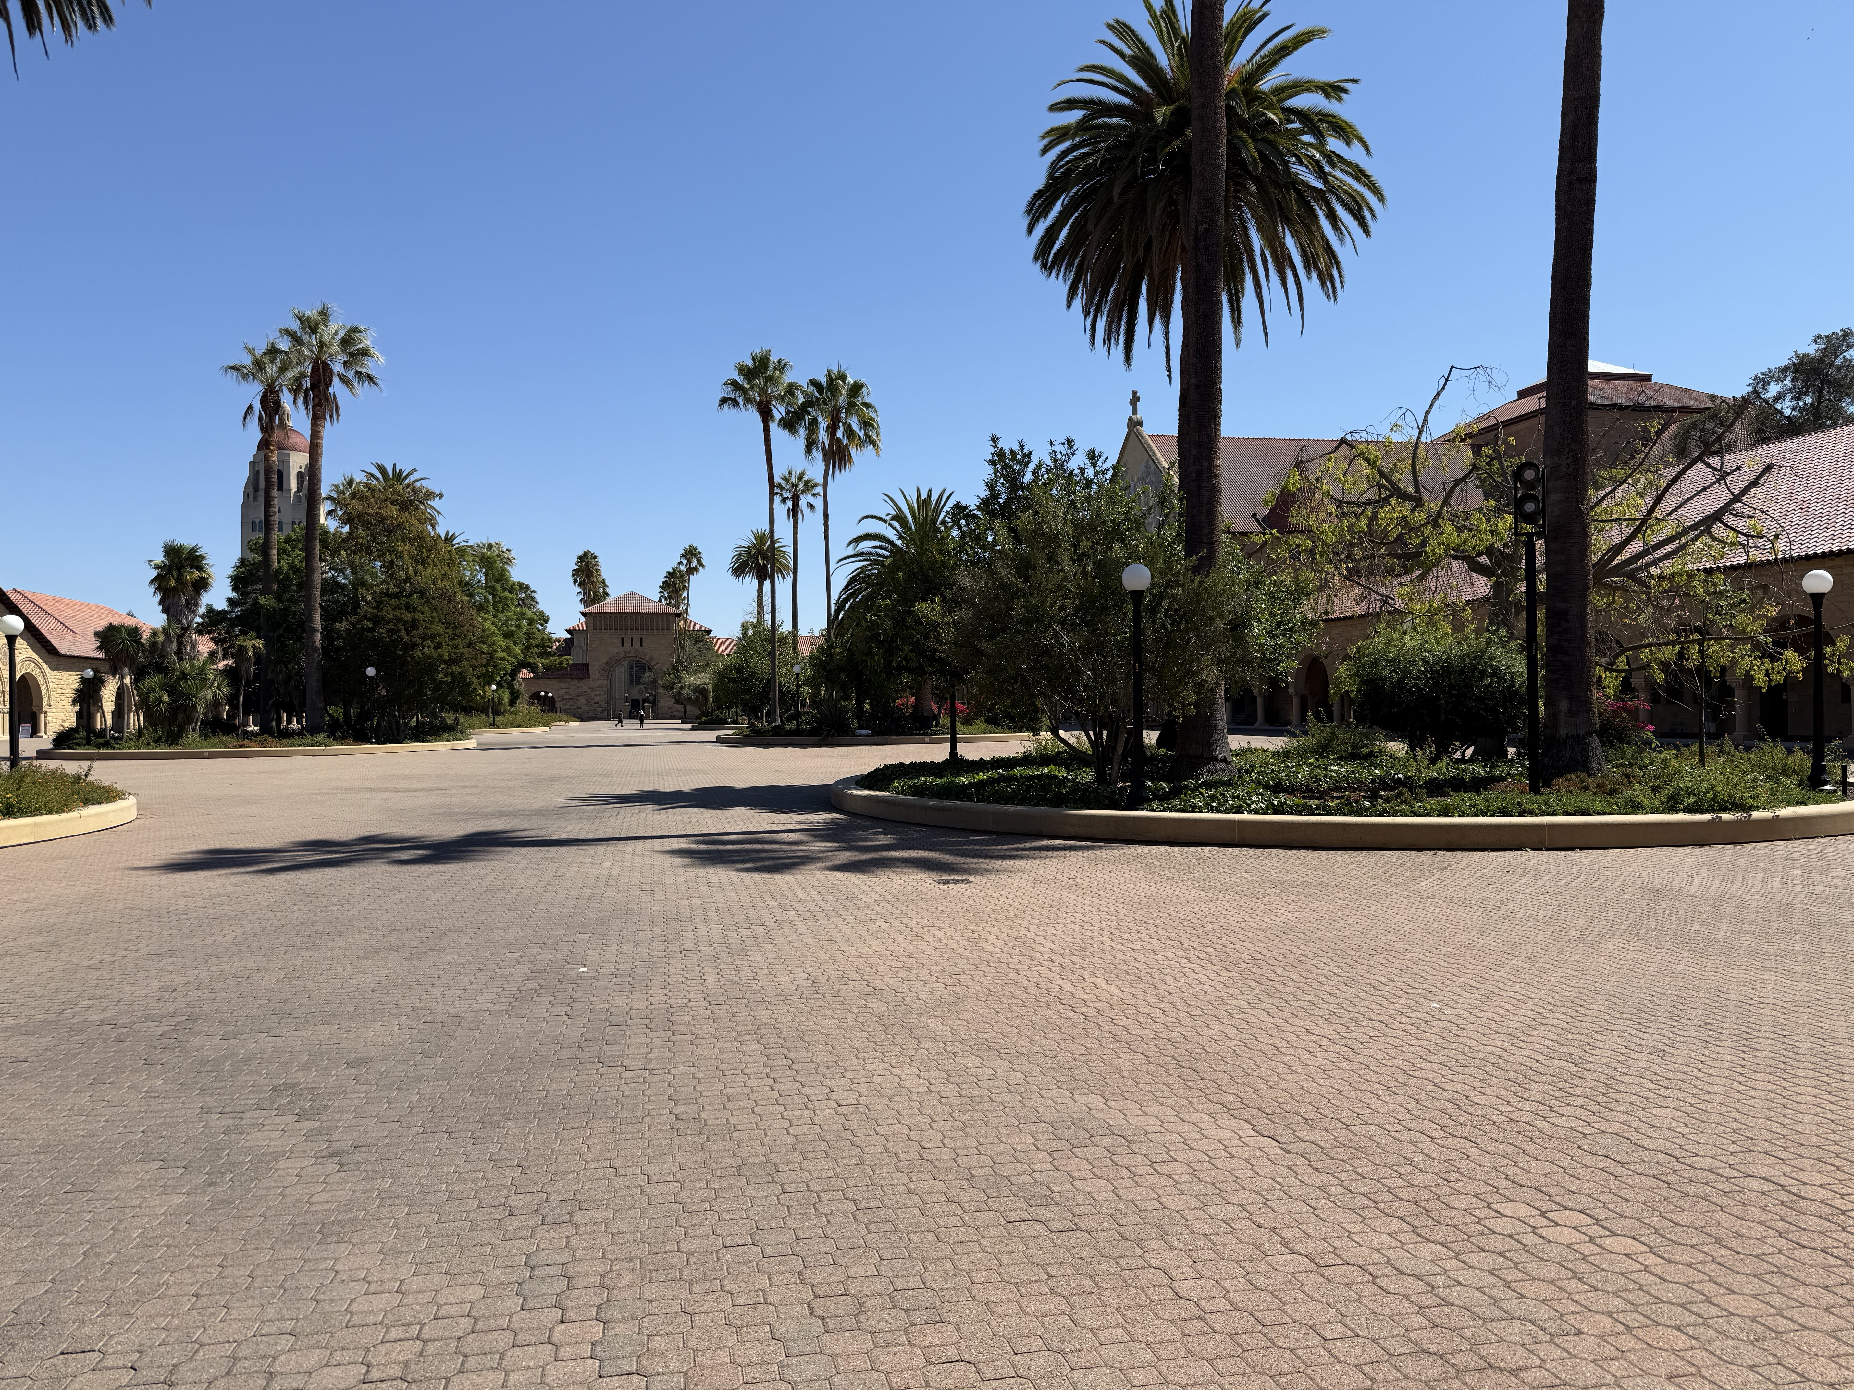








0.78$°$
1.38$°$
0.38$°$
1.10$°$
2.71$°$
1.55$°$
7$.15°$
151.89 m
1.01$°$
107.00 m
28.90 cm
61.10 m
16.90 m
23.18 m
15.20 m

